Slide 1

INC300
Week 7
Community: Social Networks
Amanda Piche, PhD Candidate
July 5th, 2018
Notes:
The lessons so far have introduced you to a variety of ways to think about your social media participation. For example, we have explored identity and the question of whether (and how) an authentic identity can be created online.
We will now turn our attention to how social media encourages groups or communities to form in online spaces. We will look at the types of social connections can be facilitated (or thwarted) by social networking sites.

Slide 2
Today’s Agenda
Check-in
Lecture
Return and take-up test

Slide 3
Lecture 7: Community - Social Networks
Learning Outcomes:
Define Key terms: Filter bubbles, homophily, social media migration.
Describe some of the reasons social networking sites manipulate what information does or does not appear in a user's newsfeed.
Describe how the move of users from MySpace to Facebook is an example of social media migration.

Slide 4
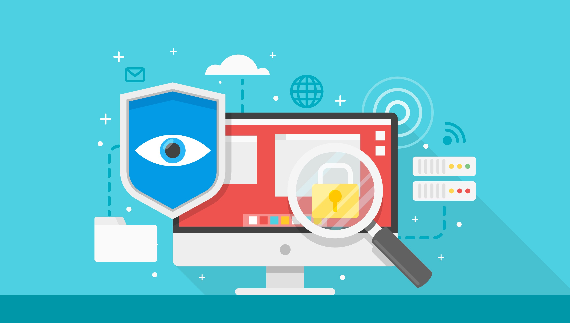
Week 6 Recap
Discussed the federal privacy law that governs citizens’ data privacy (PIPEDA) and, as an example, explored to what degree Bell Canada abides by it
Explored the framework of Privacy By Design and its’ role encouraging privacy is taken into account throughout the whole engineering process
Acquired additional strategies to protect our privacy and personal information

Slide 5
“Social Network Sites as Networked Publics: Affordances, Dynamics, and Implications”
Social networking sites as a genre of ‘networked publics’ (pg.1)
“Networked publics are publics that are restructured by networked technologies. As such, they are simultaneously (1) the space constructed through networked technologies and (2) the imagined collective that emerges as a result of the intersection of people, technology, and practice. Networked publics serve many of the same functions as other types of publics – they allow people to gather for social, cultural, and civic purposes and they help people connect with a world beyond their close friends and family. While networked publics share much in common with other types of publics, the ways in which technology structures them introduces distinct affordances that shape how people engage with these environments. The properties of bits – as distinct from atoms – introduce new possibilities for interaction. As a result, new dynamics emerge that shape participation. ” (pg. 1)

Slide 6
“Social Network Sites as Networked Publics: Affordances, Dynamics, and Implications”
“Networked publics’ affordances do not dictate participants’ behavior, but they do configure the environment in a way that shapes participants’ engagement. In essence, the architecture of a particular environment matters and the architecture of networked publics is shaped by their affordances. The common dynamics fall out from these affordances and showcase salient issues that participants must regularly contend with when engaging in these environments. Understanding the properties, affordances, and dynamics common to networked publics provides a valuable framework for working out the logic of social practices.” (1)
Affordances: the qualities or properties of an object that define its possible uses or make clear how it can or should be used.

Slide 7
“Social Network Sites as Networked Publics: Affordances, Dynamics, and Implications”
“The purpose of this article is to map out the architecture of networked publics, beginning with the bits-based nature of digital environments and then moving on to show how the affordances of networked publics are informed by the properties of bits and highlighting common dynamics that emerge from those affordances.” (1)
“In short, I contend that networked publics are publics that are restructured by networked technologies; they are simultaneously a space and a collection of people.” (3)
“The properties of bits regulate the structure of networked publics, which, in turn, introduces new possible practices and shapes the interactions that take place. These can be seen in the architecture of all networked publics, including social network sites.” (4)
Notes:
What distinguishes networked publics from other types of publics is their underlying structure. Networked technologies reorganize how information flows and how people interact with information and each other. In essence, the architecture of networked publics differentiates them from more traditional notions of publics. (3)

Slide 8
“Social Network Sites as Networked Publics: Affordances, Dynamics, and Implications”
Structural Affordances of Networked Publics
The content of networked publics is made out of bits. Both self-expressions and interactions between people produce bit-based content in networked publics. Because of properties of bits, bits are easier to store, distribute, and search than atoms. Four affordances that emerge out of the properties of bits play a significant role in configuring networked publics:
Persistence: online expressions are automatically recorded and archived.
Replicability: content made out of bits can be duplicated.
Scalability: the potential visibility of content in networked publics is great.
Searchability: content in networked publics can be accessed through search. (pg. 7)
Notes:
“Networked technologies introduce new affordances for amplifying, recording, and spreading information and social acts. These affordances can shape publics and how people negotiate them. While such affordances do not determine social practice, they can destabilize core assumptions people make when engaging in social life. As such, they can reshape publics both directly and through the practices that people develop to account for the affordances. When left unchecked, networked technologies can play a powerful role in controlling information and configuring interactions. This is one fault line that prompts resistance to and demonization of new technologies. Much of the concern stems from how the technology’s affordances inflect understood practices.” (7)

Slide 9
“Social Network Sites as Networked Publics: Affordances, Dynamics, and Implications”
Central Dynamics in Networked Publics
The affordances of networked publics introduce new dynamics with which participants must contend. Many of these dynamics are not new, but they were never so generally experienced. Three dynamics play a central role in shaping networked publics:
Invisible audiences: not all audiences are visible when a person is contributing online, nor are they necessarily co-present.
Collapsed contexts: the lack of spatial, social, and temporal boundaries makes it difficult to maintain distinct social contexts.
The blurring of public and private: without control over context, public and private become meaningless binaries, are scaled in new ways, and are difficult to maintain as distinct.
Notes:
“Defining and controlling boundaries around public and private can be quite difficult in a networked society, particularly when someone is motivated to publicize something that is seemingly private or when technology complicates people’s ability to control access and visibility.” (12)
“We need to examine people’s strategies for negotiating control in the face of structural conditions that complicate privacy and rethink our binary conceptions of public and private. While public and private are certainly in flux, it is unlikely that privacy will simply be disregarded.” (12)

Slide 10
“Social Network Sites as Networked Publics: Affordances, Dynamics, and Implications”
Transformation of Publics
“The changes brought on by networked technologies are more pervasive than those by earlier media. Because content and expressions contributed to networked publics is persistent and replicable by default, the possibility of acts being scaled, searchable, and thus viewed is heightened. Physical spaces are limited by space and time, but, online, people can connect to one another across great distances and engage with asynchronously produced content over extended periods. This allows people to work around physical barriers to interaction and reduces the cost of interacting with people in far-off places.” (13)
“In networked publics, attention becomes a commodity. There are those who try to manipulate the potential scalability of these environments to reach wide audiences, including politicians and pundits. There are also those who become the object of widespread curiosity and are propelled into the spotlight by the interwoven network. There are also the countless who are not seeking nor gaining widespread attention. Yet, in an environment where following the content of one’s friends involves the same technologies as observing the follies of a celebrity, individuals find themselves embedded in the attention economy, as consumers and producers.” (13)
“Persistence and replicability also complicate notions of “authenticity,” as acts and information are not located in a particular space or time and, because of the nature of bits, it is easy to alter content, making it more challenging to assess its origins and legitimacy. “ (!3)
“While there are limits to how many people can be in one physical space at a time, networked publics support the gathering of much larger groups, synchronously and asynchronously.” (13)

Slide 11
“Social Network Sites as Networked Publics: Affordances, Dynamics, and Implications”
Ultimately:
Many of the struggles that take place on social network sites are shaped by the properties of bits, the affordances of networked publics, and the resultant dynamics. While some of the specific factors are not unique to networked publics, the prevalence of social network sites has introduced these affordances and dynamics to a much broader subset of the population.
However, people are learning to work within the constraints and possibilities of mediated architecture, just as people have always learned to navigate structures as part of their daily lives.
The affordances and dynamics of networked publics can shed light on why people engage the way they do.
Notes:
“Thus, taking the structural elements of networked publics into account when analyzing what unfolds can provide a valuable interpretive framework.” 15

Slide 12
The Study of Social Networks
The study of social networks is an attempt to understand social interaction between at least two parties. Depending on the level of analysis and the questions being asked, the social actors under investigation may be individuals, groups, or organizations. However, in all cases, the study of social networks is the study of who connects with who (and for what reasons).
Social network analysis [SNA] is the mapping and measuring of relationships and flows between people, groups, organizations, computers, URLs, and other connected information/knowledge entities. The nodes in the network are the people and groups while the links show relationships or flows between the nodes. SNA provides both a visual and a mathematical analysis of human relationships
Notes:
A social network is defined as a chain of individuals and their personal connections.

Slide 13
“A Social Network Caught in the Web” by Adamic, Buyukkokten and Adar (2003)
an example of what an analysis of a social network might look like
a preliminary social network analysis of Club Nexus, an online community at Stanford University
through the Nexus site they were able to study a reflection of the real world community structure within the student body.
the data presents an opportunity to study, among other things, the online community's structure, social interactions and how factors such as personality and interests influence one's choice of friends
study observed and measured social network phenomena such as the small world effect, clustering, and the strength of weak ties.
Using the rich profile data provided by the users they were able to deduce the attributes contributing to the formation of friendships, and to determine how the similarity of users decays as the distance between them in the network increases.
In addition, they found correlations between users' personalities and their other attributes, as well as interesting correspondences between how users perceive themselves and how they are perceived by others.
Notes:
Club Nexus was introduced at Stanford in the fall of 2001. It is a system devised by students to serve the communication needs of the Stanford online community. Students can use Club Nexus to send e-mail and invitations, chat, post events, buy and sell used goods, search for people with similar interests, place personals, display their artwork or post editorial columns.
Small world effect: where the distance between any two users, measured in the number of hops along the Nexus Net, is only four on average
Clustering: results review that there is a significant amount of structure in the social interactions reported in Club Nexus

Slide 14
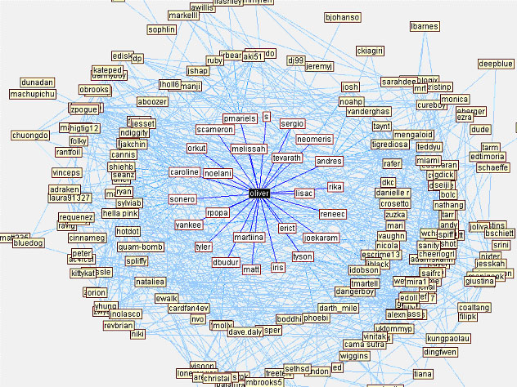
“A Social Network Caught in the Web” by Adamic, Buyukkokten and Adar (2003)
Notes:
Club Nexus was introduced at Stanford in the fall of 2001. It is a system devised by students to serve the communication needs of the Stanford online community. Students can use Club Nexus to send e-mail and invitations, chat, post events, buy and sell used goods, search for people with similar interests, place personals, display their artwork or post editorial columns.
Small world effect: where the distance between any two users, measured in the number of hops along the Nexus Net, is only four on average
Clustering: results review that there is a significant amount of structure in the social interactions reported in Club Nexus

Slide 15
Social Networks
You should expect that similar research as what was conducted by Adamic et al. has been and continues to be done on your own social media profiles, but in this case done by the in-house research teams employed by Facebook, Twitter, and other social network sites. A recent example of such research was Facebook’s experiment to see if they can manipulate a user’s mood.
This experiment was conducted by hiding posts made by a user’s friends that an automated algorithm determined was a positive or negative post.

Slide 16
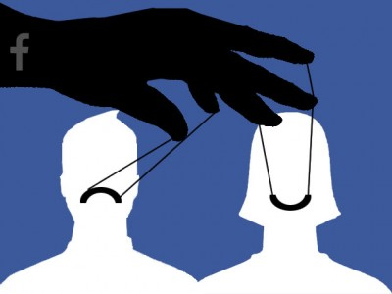
Facebook’s Psychological Study
Notes:
Video embedded in photo: https://www.youtube.com/watch?v=oruh5Hb_95I

Slide 17
Social Networks
A theme running throughout this course is that the social networking sites that make up a large portion of our online social interactions are privately held companies. When you signed up for a particular social networking site, you were likely presented with the Terms of Service, or the rules for your participation in this site. By clicking “I agree” to the Terms of Service, you also consented to participating in any studies a social networking site might wish to conduct, such as the Facebook timeline manipulation study.
That you may possible be part of a research study (with or without your knowledge) may be worth the tradeoff for the value and pleasure you get out of participating in a social networking site. However, this is something that you must consider as you move forward with this course and make decisions about what social networking sites (if any) you will join or continue to participate in after INC 300 concludes.

Slide 18
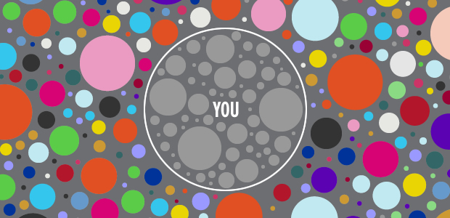
The Filter Bubble
The Facebook mood manipulation experiment involved the creation and manipulation of what has been come to known as a “filter bubble”. You may have also heard of this being called an “echo chamber”.
Eli Pariser’s TED Talk (cited in the next few slides) explores the concept filter bubbles, and enables us to understand how what makes it into your timeline or newsfeed can be artificially limited.
Notes:
Put a definition of filter bubble here

Slide 19
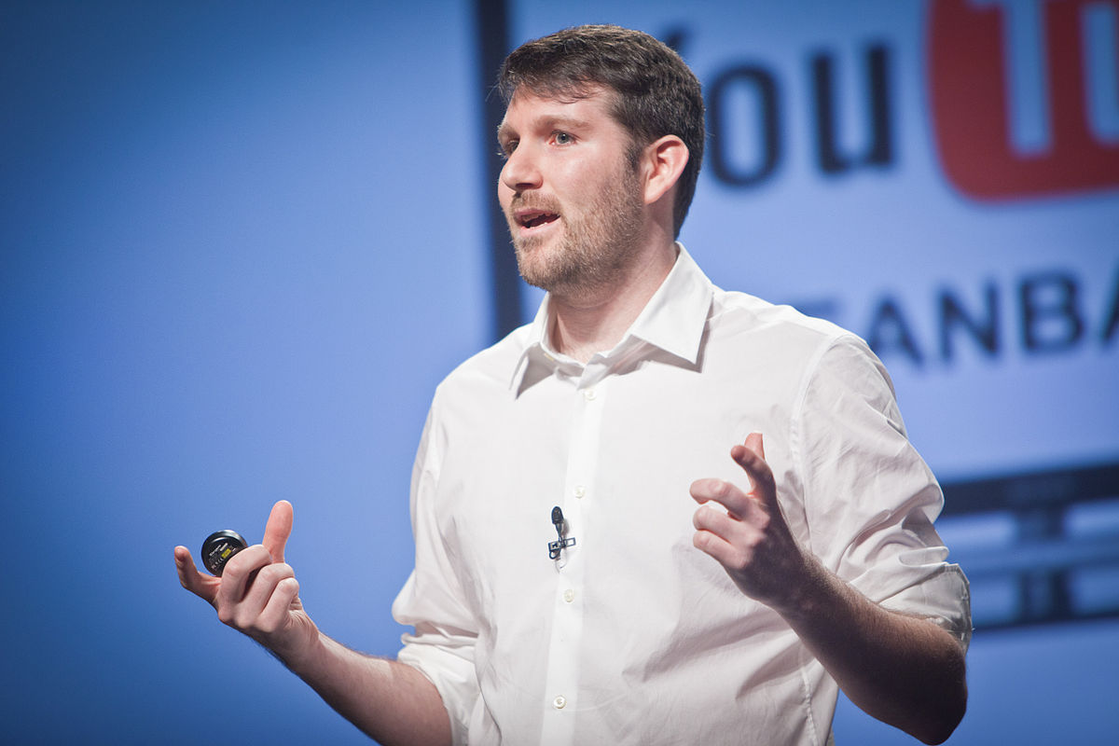
The Filter Bubble
“[The Internet] meant something that would connect us all together. And I was sure that it was going to be great for democracy and for our society. But there's this shift in how information is flowing online, and it's invisible. And if we don't pay attention to it, it could be a real problem. So I first noticed this in a place I spend a lot of time -- my Facebook page. I'm progressive, politically -- big surprise -- but I've always gone out of my way to meet conservatives. I like hearing what they're thinking about; I like seeing what they link to; I like learning a thing or two. And so I was surprised when I noticed one day that the conservatives had disappeared from my Facebook feed. And what it turned out was going on was that Facebook was looking at which links I clicked on, and it was noticing that, actually, I was clicking more on my liberal friends' links than on my conservative friends' links. And without consulting me about it, it had edited them out. They disappeared.”

Slide 20
The Filter Bubble
“So Facebook isn't the only place that's doing this kind of invisible, algorithmic editing of the Web. Google's doing it too. If I search for something, and you search for something, even right now at the very same time, we may get very different search results. Even if you're logged out, one engineer told me, there are 57 signals that Google looks at -- everything from what kind of computer you're on to what kind of browser you're using to where you're located -- that it uses to personally tailor your query results. Think about it for a second: there is no standard Google anymore. And you know, the funny thing about this is that it's hard to see. You can't see how different your search results are from anyone else's.”

Slide 21
The Filter Bubble
“So it's not just Google and Facebook either. This is something that's sweeping the Web. There are a whole host of companies that are doing this kind of personalization. Yahoo News, the biggest news site on the Internet, is now personalized -- different people get different things. Huffington Post, the Washington Post, the New York Times -- all flirting with personalization in various ways. And this moves us very quickly toward a world in which the Internet is showing us what it thinks we want to see, but not necessarily what we need to see.”

Slide 22
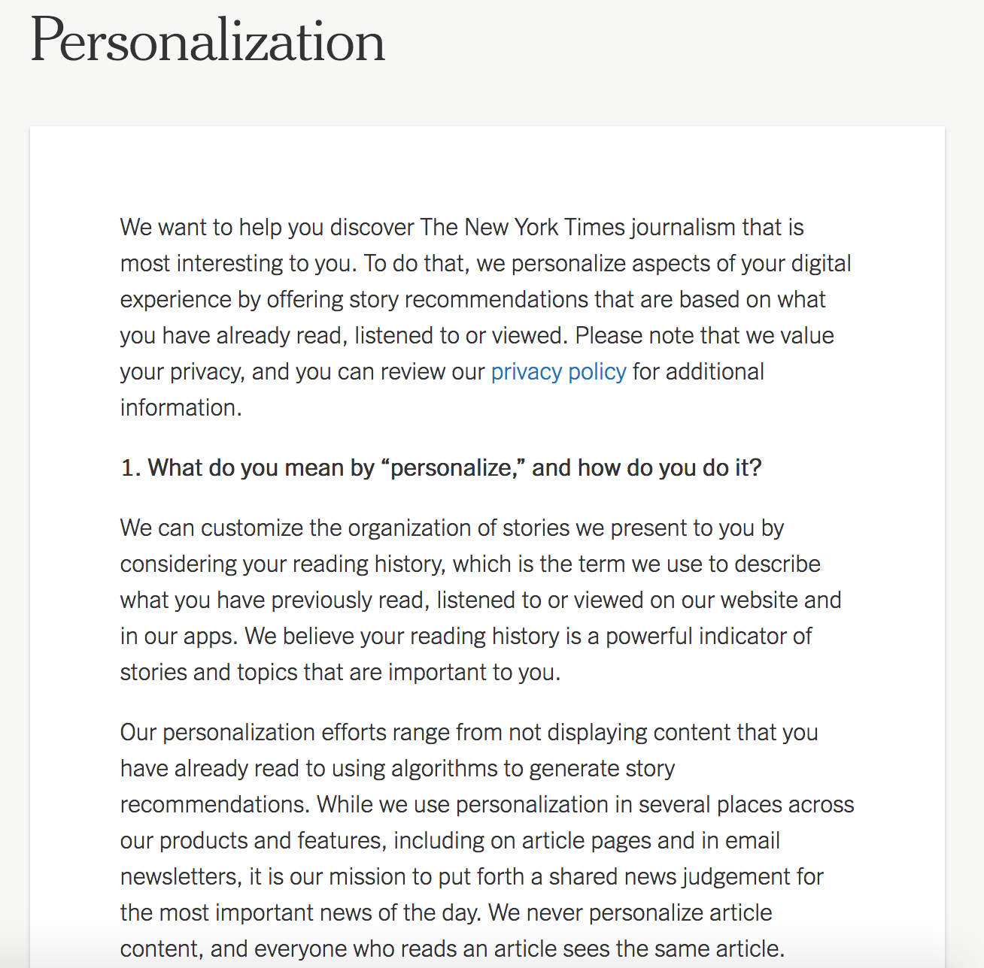
The Filter Bubble
New York Times description of personalization on their site
Notes:
https://help.nytimes.com/hc/en-us/articles/360003965994-Personalization

Slide 23
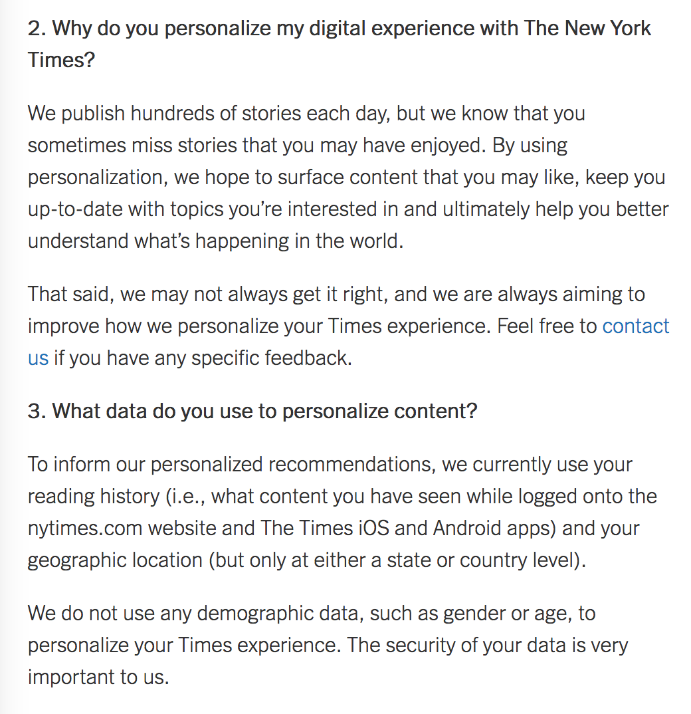
The Filter Bubble
New York Times description of personalization on their site
Notes:
https://help.nytimes.com/hc/en-us/articles/360003965994-Personalization

Slide 24
The Filter Bubble
“So I do think this is a problem. And I think, if you take all of these filters together, you take all these algorithms, you get what I call a filter bubble. And your filter bubble is your own personal, unique universe of information that you live in online. And what's in your filter bubble depends on who you are, and it depends on what you do. But the thing is that you don't decide what gets in. And more importantly, you don't actually see what gets edited out.”

Slide 25
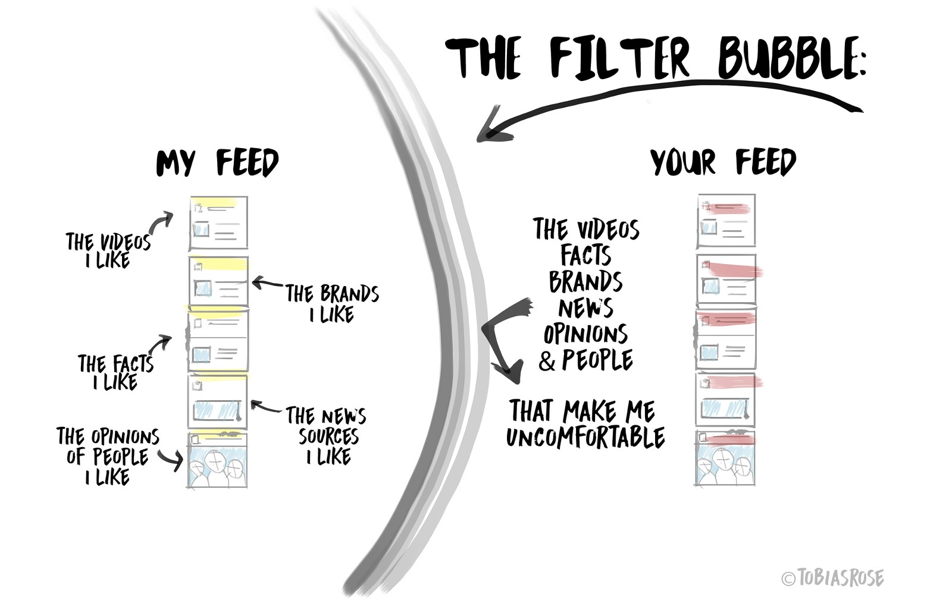
The Filter Bubble
In other words:
A filter bubble is the intellectual isolation that can occur when websites make use of algorithms to selectively assume the information a user would want to see, and then give information to the user according to this assumption.

Slide 26

Activity (in pairs):
Visit: http://graphics.wsj.com/blue-feed-red-feed/ . What are your reactions to this? What is the value of personalized filter bubbles for search engines and advertisers?
Review your own social media search bubbles individually (i.e. browse your Facebook, Instagram, Twitter timelines, review your browsing history). What websites or accounts appear? What perspectives dominate?
Ask yourselves: could filter bubbles be a problem? Why?
Notes:
Objective of activity: demonstrate disparity in political news, in customization of individual feeds; seek out and evaluate different media in order to expand one’s scope of knowledge
To illustrate the disparity in political news on Facebook, The Wall Street Journal created “Blue Feed, Red Feed,” a tool that gives users a side-by-side look at how conservative and liberal news sources are talking about divisive topics such as guns, ISIS, Donald Trump, and Facebook itself. It’s not a complete reflection of the average person’s Facebook feed, which draws from many sources, but for many users, it will be an eye-opening, likely uncomfortable peek at another reality.
The data for The Wall Street Journal project comes via a 2015 Facebook study that examined the sharing behavior of 10 million Facebook users who identified their political leanings. Facebook tracked the users over six months, monitoring the content they shared and determining whether it was very liberal, liberal, neutral, conservative, or very conservative.

Slide 27
The Filter Bubble
“It gives us some information vegetables; it gives us some information dessert. And the challenge with these kinds of algorithmic filters, these personalized filters, is that, because they're mainly looking at what you click on first, it can throw off that balance. And instead of a balanced information diet, you can end up surrounded by information junk food.”

Slide 28
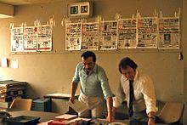
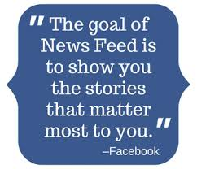
The Filter Bubble
“In a broadcast society -- this is how the founding mythology goes -- in a broadcast society, there were these gatekeepers, the editors, and they controlled the flows of information. And along came the Internet and it swept them out of the way, and it allowed all of us to connect together, and it was awesome. But that's not actually what's happening right now. What we're seeing is more of a passing of the torch from human gatekeepers to algorithmic ones. And the thing is that the algorithms don't yet have the kind of embedded ethics that the editors did. So if algorithms are going to curate the world for us, if they're going to decide what we get to see and what we don't get to see, then we need to make sure that they're not just keyed to relevance. We need to make sure that they also show us things that are uncomfortable or challenging or important”

Slide 29
The Filter Bubble
All of your interactions with a social networking site will inform the site about your browsing habits, which in turn can be used to better serve you advertisements. By not showing you content that you might find disagreeable (e.g. links posted by people on your friends list that share an opposing political viewpoint), a SSN’s aim is to keep you active and logged in to the site as long as possible. If something that appears in your timeline is offensive, you may decide to log off the SSN to clear your head.
Finally, it is important to remember that you may never be getting “the full story” if you rely solely on social networking sites to keep you informed of world events. They can be part of your information diet, but as the filter bubble has illustrated, they should never be your only source of news and current events.

Slide 30
Question:
How can we pop the filter bubble?

Slide 31
Popping the filter bubble?
Diversify your media diet - Diversifying the kind of news and information someone consumes helps in understanding the other side’s point of view.
Don’t rely solely on social media or search engines - Because social media isn't dedicated to balancing news feeds with varying points of view and instead tailors news to users based on what they like, it's dangerous if it's the only source of news.
Humanize your conversations - Using emotional phrases in conversations or in online exchanges such as, “I hear you …” or “I feel like …” or asking, “Why do you feel this way?” helps people to feel they’re having a conversation rather than an argument.
Take the conversation offline - Limiting political conversations and interactions to social media gives users more chances to see people out of their true context
Are algorithms the next step? - Algorithms may be able to help us step out of our echo chambers
Notes:
https://www.deseretnews.com/article/865668236/4-ways-to-burst-the-6filter-bubble7-isolating-you-from-different-viewpoints.html
https://slate.com/technology/2018/04/personalization-algorithms-could-actually-help-pop-filter-bubbles.html

Slide 32
Homophily
While the filter bubble is an example of how social networking sites might manipulate what is at the top of your newsfeed for the sake of keeping you happy and engaged (and in the range of advertisements), this is not the only way that our exposure to alternative or opposing viewpoints can be limited.
Social networking sites can be ripe for homophily. “Homophily is the principle that a contract between similar people occurs at a higher rate than among dissimilar people” (“Birds of a Feather: Homphily in Social Networks,” McPherson, Smith-Lovin, & Cook, 2001, p.416).

Slide 33
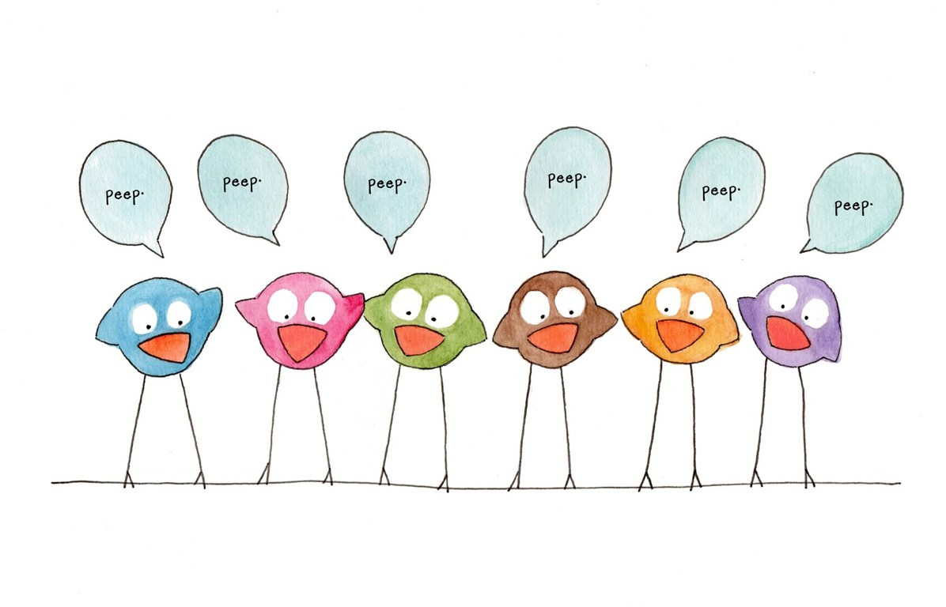
Homophily
You may have already been introduced to this concept through how it is more colloquially discussed, the proverb that “birds of a feather flock together”. Sociologists have long observed that friendship groups tend to form along shared social markers such as gender, age, religion, race or occupation. It should not be surprising that this practice also influences who we connect with on social networking site.

Slide 34
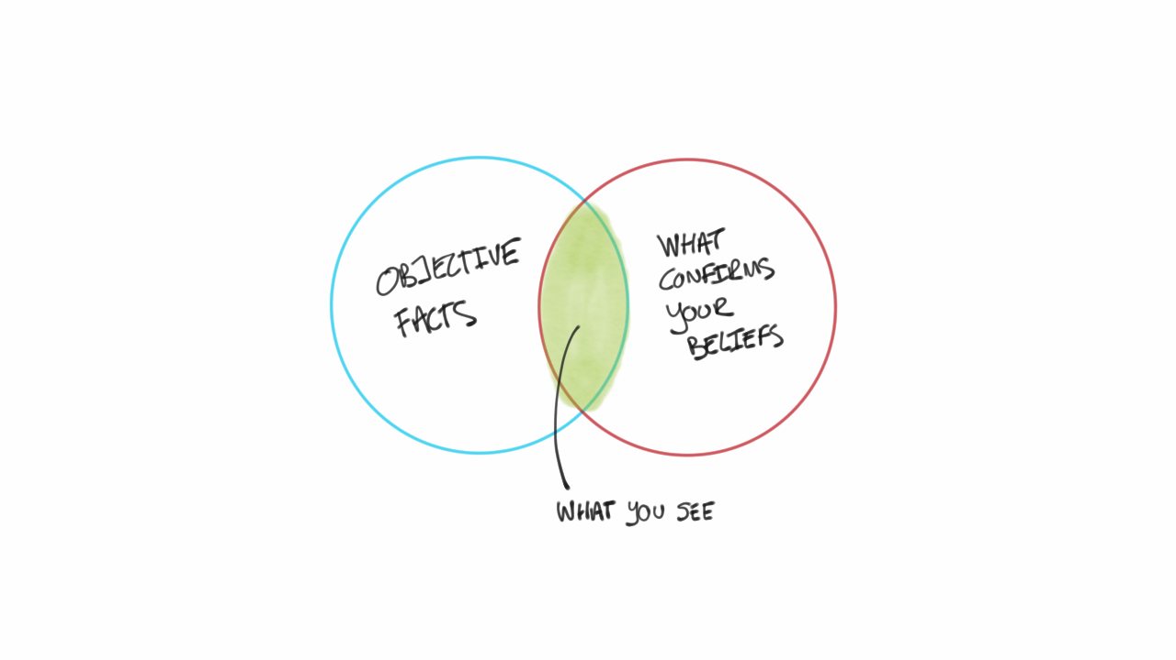
Homophily
Homophily can also lead to the misunderstandings. There are consequences when our imagined audiences do not reflect the actual audiences who are reading our posts on a social networking site.
The Internet did not live up to initial promises that it would be a place to experiment with identity, nor did it usher in an age of post-racism, post sexism, etc. Similarly, social networking sites did not necessarily expose us to a wider variety of people beyond who we will naturally come across in the patterns of our day-to-day lives.
Both the filter bubbles of social networking sites, but also our own habits of not tending to connect with others who are extremely different from us, means that it can be easy to fall into old patterns and confirmation biases.
Notes:
Confirmation bias, also called confirmatory bias or myside bias, is the tendency to search for, interpret, favor, and recall information in a way that confirms one's preexisting beliefs or hypotheses.

Slide 35

Homophily
danah boyd, an Internet researcher, has spent considerable time interviewing users of particular social media sites. She writes:
  “Throughout my studies of social media, I have been astonished by the people who think that XYZ site is for people like them. I interviewed gay men who thought Friendster was a gay dating site because all they saw were other gay men. I interviewed teens who believed that everyone on MySpace was Christian because all of the profiles they saw contained biblical quotes. We all live in our own worlds with people who share our values and, with networked media, it's often hard to see beyond that.” (boyd, 2009)

Slide 36

Homophily
This is not to say that using social networking sites to keep connections alive with your current friends is a bad thing. However, this discussion of homophily should be taken as a reminder that social media can be a way to expose yourself to new ideas and viewpoints beyond those frequently expressed by the community that immediately surrounds you, but only if you consciously set out to do so.
This is especially true on sites like Twitter, where following someone you don’t know face-to-face is not considered a violation or a breach of the site’s norms.
Consider signing up for a new social networking site, or following a new group of users on a site you already participate in. This can be an excellent way to expand your horizons, and you may even make some new friends!

Slide 37
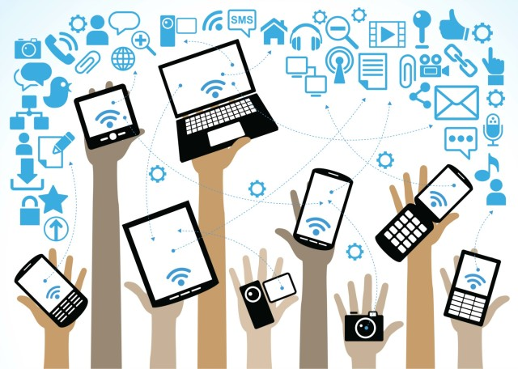
Social Media Migration
Recall in our first lecture, a social networking site was defined as needing to exhibit the following characteristics:
  The ability for a user to construct a public or semi-public profile on the website.
  The ability to create a list of other users with whom they share a connection.
  The ability to view and click on the links to view this list of connections (boyd & Ellison 211).

Slide 38

Social Media Migration
Social network analysis can help us better understand how popularity of social media sites can shift over time. In particular, a social network analysis can be used to identify “tipping points” where enough users have abandoned one social media site in favour of another. Because a key feature of social networking sites is the ability to identify who your friends are and make connections with them, a social networking site loses its appeal (and utility) if your friends no longer log in to a particular site.
A prime example of everything discussed thus far in this lesson is the migration that happened from MySpace to Facebook between 2006 and 2008. In the History of Social Media lecture, we explored the history of social networking sites, including the rise of Facebook. The teens who flocked to Facebook after it no longer required an edu email account were not first-time social networking site users. Instead, many had previously been active on MySpace.

Slide 39
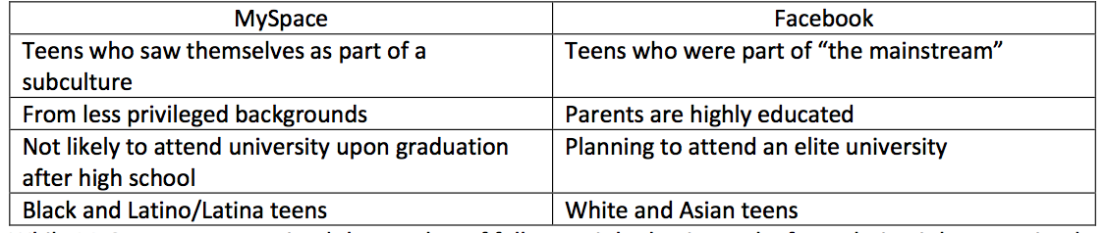
Social Media Migration
danah boyd interviewed 103 teens who were active users of social media. In her analysis, boyd found that the migration between the sites, especially who stayed on MySpace and who left for Facebook, was heavily dependent on race and class. She found evidence of self-sorting in terms of participation in the two sites.
Notes:
boyd, dana. (2013). “White flight in networked publics?. How Race and Class Shaped American Teen Engagement with Myspace and Facebook." Race after the Internet. Ed. Lisa Nakamura and Peter A. Chow-White. Routledge, 203-22.

Slide 40
Social Media Migration
While MySpace never regained the number of followers it had at its peak of popularity, it has remained a social networking site utilized by teens. These users, however, were not well regarded by teens that left MySpace to become Facebook users. In her interviews with former MySpace interviews who had left in favour of Facebook, she found that these teens used the same sort of descriptors that are used by people who leave the city centre in favour of the suburbs.
She elaborates:
“The language used in these remarks resembles the same language used throughout the 1980s to describe city dwellers: dysfunctional families, perverts and deviants, freaks and outcasts, thieves, and the working class. Implied in this is that no decent person could possibly have a reason to dwell in the city or on MySpace. While some who didn’t use MySpace were harshly critical of the site, others simply forgot that it existed. They thought it to be irrelevant, believing that no one lived there anymore simply because no one they knew did.”
(2013, p. 218)
Notes:
boyd, dana. (2013). “White flight in networked publics?. How Race and Class Shaped American Teen Engagement with Myspace and Facebook." Race after the Internet. Ed. Lisa Nakamura and Peter A. Chow-White. Routledge, 203-22.

Slide 41
Social Media Migration
Many of the teens that boyd interviewed who left MySpace for Facebook had assumed that the site had died off. This mirrored many reports at the time, that MySpace had been “killed” by Facebook, and that it was only a matter of time before the site would be completely shuttered.
This perception that MySpace was dead - despite thousands of active users still participating in the site - is largely the result of homophily. Because no one in their network of social connections appeared to be active on MySpace, they erroneously assumed that there was no one left on the site.
The larger lesson here is that social networking sites can lead to confirmation bias or an echo chamber where things that you already believe become reinforced, and you are not exposed to alternate viewpoints or perspectives.
Notes:
boyd, dana. (2013). “White flight in networked publics?. How Race and Class Shaped American Teen Engagement with Myspace and Facebook." Race after the Internet. Ed. Lisa Nakamura and Peter A. Chow-White. Routledge, 203-22.

Slide 42
Looking Forward
In this lesson, we have explored the types of connections that can be made, aided by participation in social networking sites. It has focused primarily on the ways we self-select into particular groups, or how automated algorithms select what information we are exposed to in our newsfeeds.
As with the rest of this course, this lesson should not be taken as an indictment or critique of social media. Instead, this is additional information for your toolkit to better understand how the structures and dynamics of social networking sites can affect the populations who participate in them.
This is also information to help inform your decisions and actions about where and how you want to protect your privacy and control over your personal information.
Next week, we will explore social networks from the perspective of how social networking sites can bring together people from all over the world who share a common interest.
Notes:
boyd, dana. (2013). “White flight in networked publics?. How Race and Class Shaped American Teen Engagement with Myspace and Facebook." Race after the Internet. Ed. Lisa Nakamura and Peter A. Chow-White. Routledge, 203-22.

Slide 43
Lecture 7: Community – Social Networks
In this lesson, we have explored:
What research involving a social network analysis might look like and an example of research conducted by Facebook (the newsfeed manipulation study).
The concepts of the filter bubble and homophily, and how they are related to the variety and diversity of information you might see in your social networking newsfeeds.
The migration of users between social networking sites and how our personal networks may blind us to how other users interact with sites that we no longer participate in.

Slide 44
For next week:
Next week’s class (July 12th) will be in-class!
Lecture material will be made available online and must be read before class
Ensure you post one tweet and two replies on Twitter before our next meeting on the topic of Social Networks
Mini-lesson #2: The reading material for the mini-lesson will be made available online and must be read by July 11th. By July 11th, students must respond to one writing prompt, and must reply to one of their classmates’ posts.
Note! Social Media Strategy Document due on via e-mail BEFORE 7pm, July 12th.

